Slide 1


Adversarial Attacks on MNIST
Exploring White-box and Black-box Evasion Attacks using ART Library
Presented by : Reem AL-ZOUHBY August 18, 2025

Slide 2
A
Explore Adversarial Attacks
.
Plan
White box attack
.
B
C
Black Box Attack
Explore the poisoning attack
D
E
Explore the Demo APP!!

Slide 3
Explore Adversarial Attacks
.
A
What’s Adversarial Attacks???

Slide 4
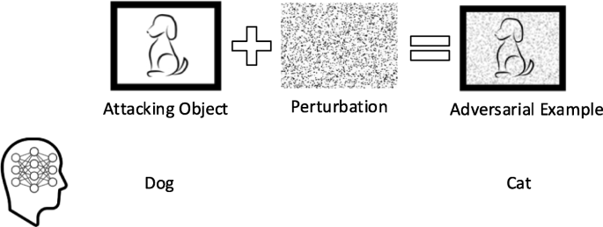

Slide 5
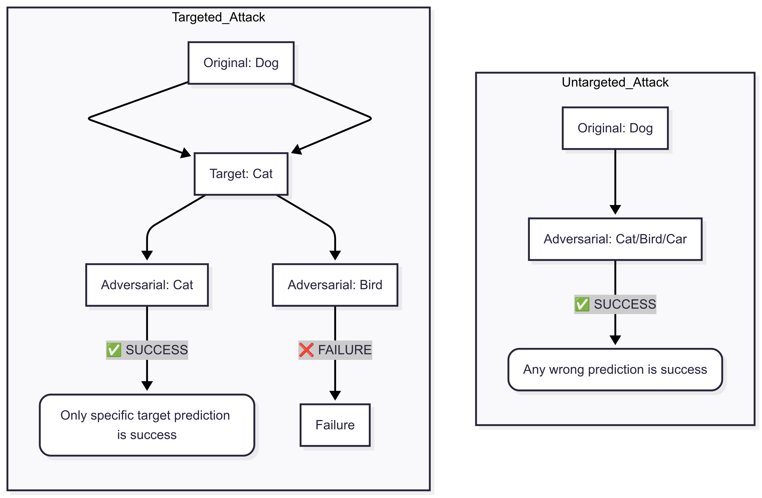

Slide 6
Let's Explore Adversarial Attacks 🚀
MNIST
Model
Split
Model Access
No Model Access
White-box
Black-box
Attacks
Attacks
FGSM
C&W
Transfer
Genetic
Fast
PGD
Optimal
Based
Query
Algo
Iterative
Based

Slide 7
A
Explore Adversarial Attacks
.
Knowledge-Based Attack Methods
White box attack
.
.
B

Slide 8
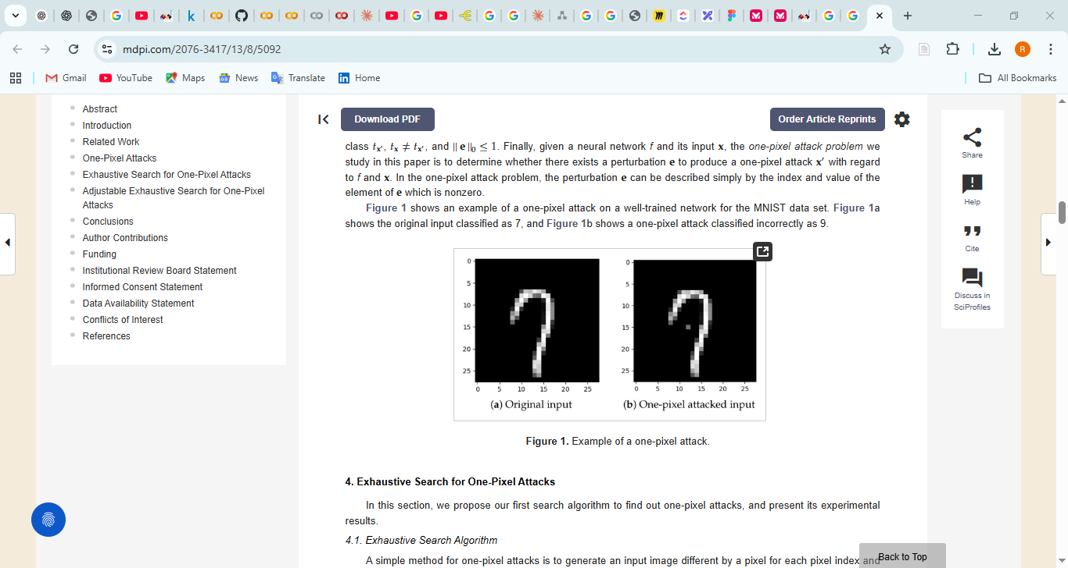
Clean Input
Full Model Access
FGSM
Generate Perturbation
Adversarial Example
Wrong Output Predicted
PGD
C&W

Slide 9

Let’s zoom into PGD (Projected Gradient Descent)

Slide 10
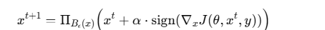
PGD: Projected Gradient Descent - Iterative Process
Gradient of loss function
x^(t+1) = Π_{B_ε(x)} (x^t + α · sign(∇_x J(θ, x^t, y)))
Iterative formula applied for t = 0, 1, 2, ..., T-1
max perturbation allowed
Step 1: Initialize
Target Label
1
step size per iteration
x^0 = x (original input image)
Step 2: First Iteration (t = 0)
2
x^1 = Π_{B_ε(x)} (x^0 + α · sign(∇_x J(θ, x^0, y)))
Step 3: Second Iteration (t = 1)
3
x^2 = Π_{B_ε(x)} (x^1 + α · sign(∇_x J(θ, x^1, y)))
Step 4+: Continue Iterating
...
Repeat until t = T-1, then return x^T (final adversarial example)

Slide 11


Slide 12
1. Load Data
2. Load Model
3. Setup ART
MNIST Dataset
Pre-trained CNN
KerasClassifier
Normalize (0-1)
mnist_model.h5
Wrapper
4. Configure PGD Attack
PGD Iteration Details
eps_step = 0.03 (step size α)
For t = 0 to 9:
eps = 0.4 (max perturbation ε)
1. Compute gradient ∇J
max_iter = 10 (T iterations)
2. Take sign of gradient
3. Step: x + 0.03 × sign(∇J)
4. Project onto ε-ball (0.4)
5. Repeat until t = 10
5. Generate Attack
6. Evaluation
Mathematical Form:
x_test_adv =
Clean vs Adversarial
x^(t+1) = Π(x^t + α·sign(∇J))
attack.generate()
Accuracy
7. Results Analysis
Clean Test Accuracy
Adversarial Accuracy
Accuracy Drop
Visualization
~98%+
Much Lower!
Significant!
50 Examples

Slide 13
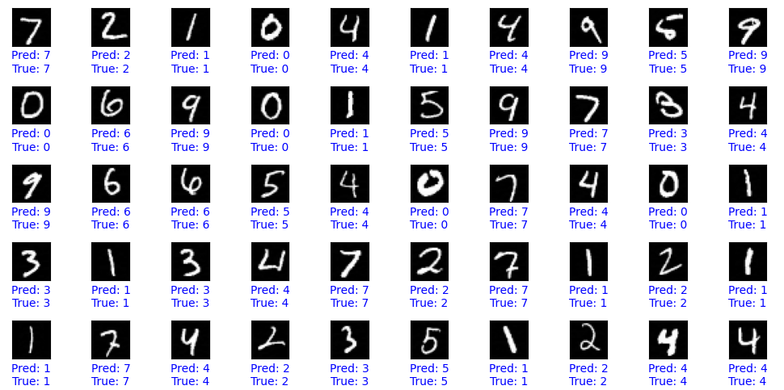
Pgd epsi=0.05
Accuracy on clean test examples: 0.9913
Accuracy on adversarial test examples: 0.9817
Accuracy drop due to adversarial attack: 0.0096
Number of correct predictions: 9817
Number of wrong prediction : 183
Total test samples: 10000

Slide 14
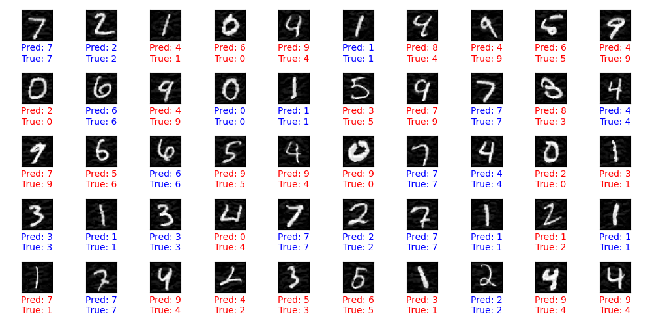
Pgd epsi =0.4
Accuracy on clean test examples: 0.9913
Accuracy on adversarial test examples: 0.4996
Accuracy drop due to adversarial attack: 0.4917
Number of correct predictions: 4996
Number of wrong prediction : 5004
Total test samples: 10000

Slide 15
Let’s zoom into BIM (Basic Iterative Method)

Slide 16
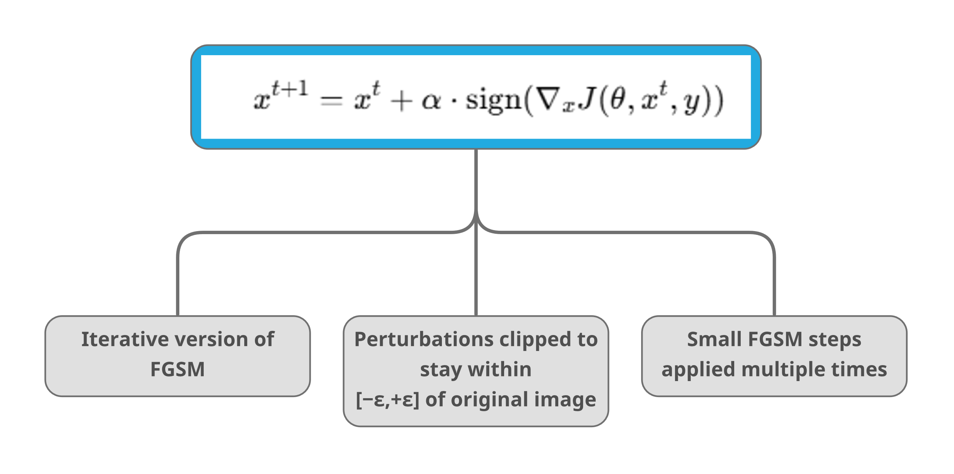

Slide 18
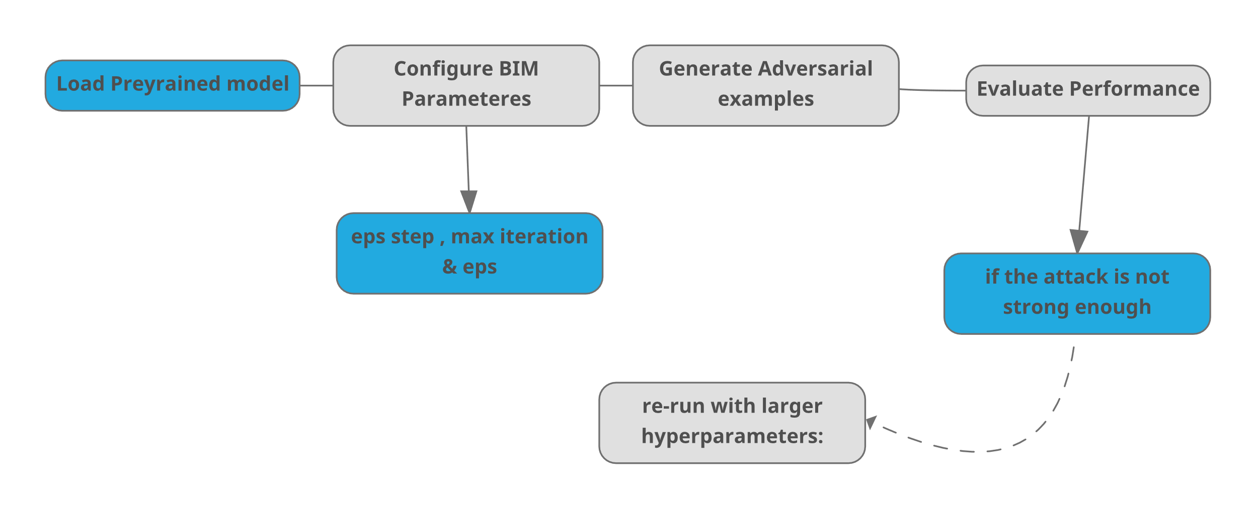

Slide 19
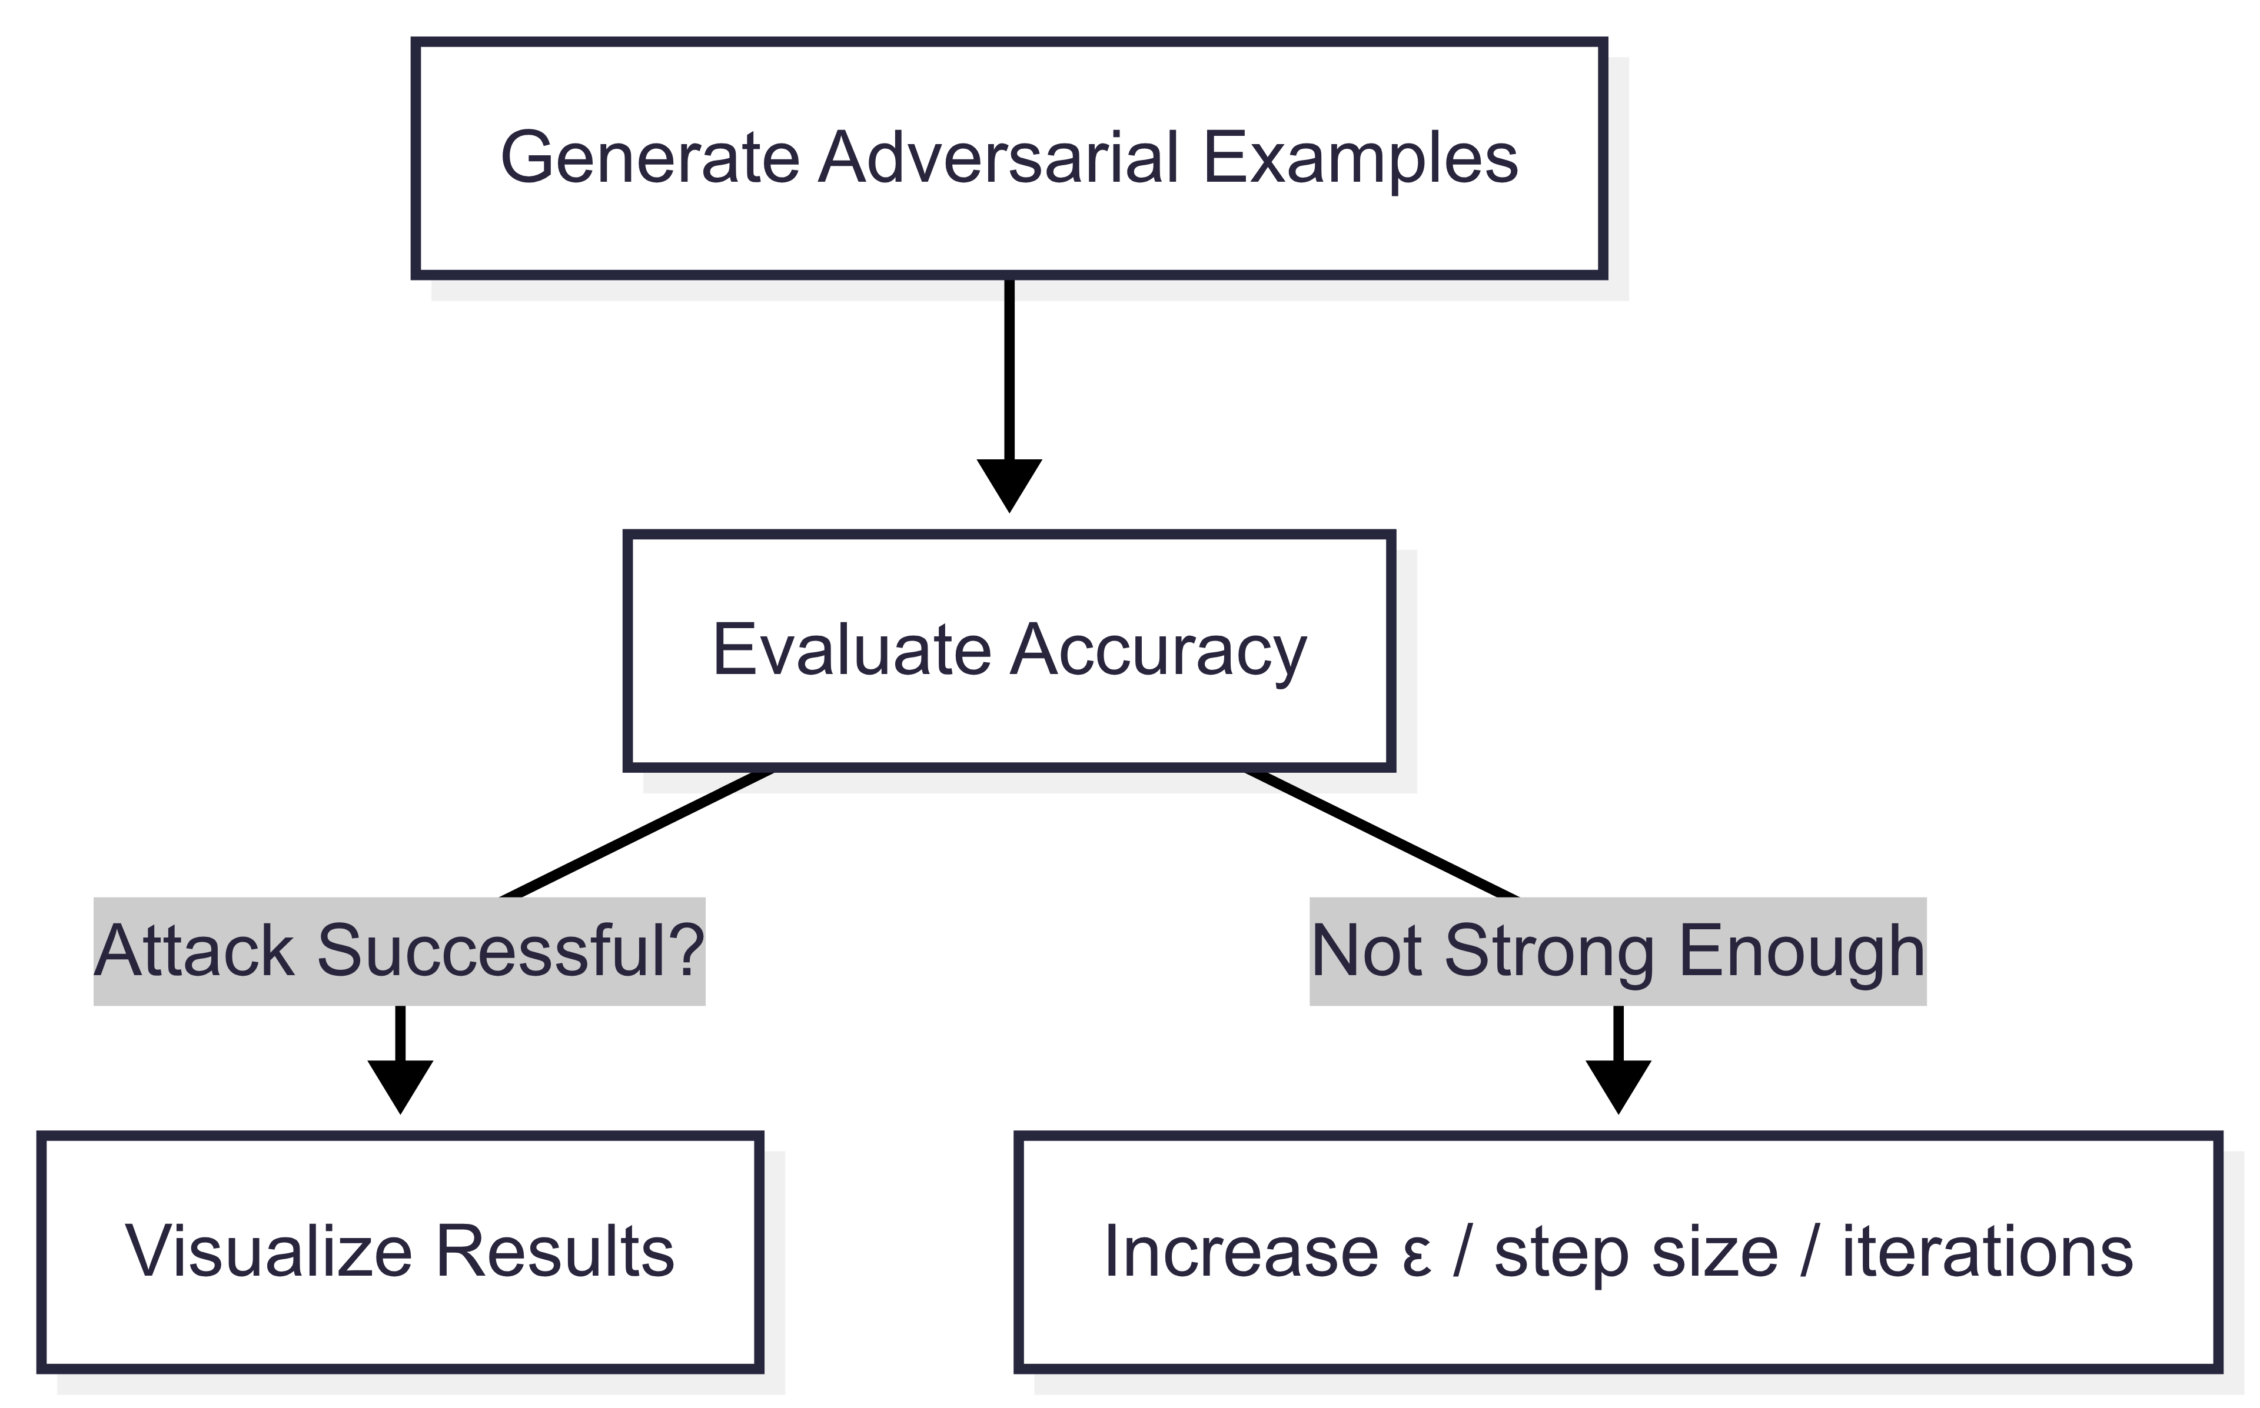

Slide 20
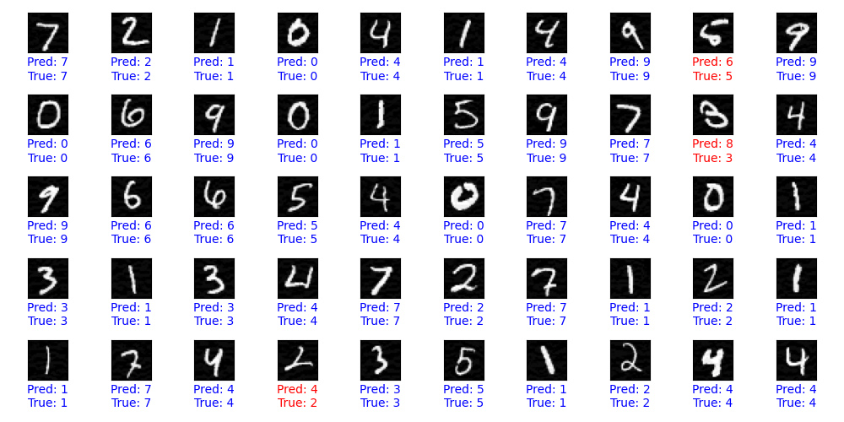
BIM = Basic Iterative Methode Eps=0.05
Accuracy on clean test examples: 0.9913
Accuracy on adversarial test examples: 0.9484
Accuracy drop due to adversarial attack: 0.0429
Number of correct predictions: 9484
Number of wrong prediction : 516
Total test samples: 10000

Slide 21
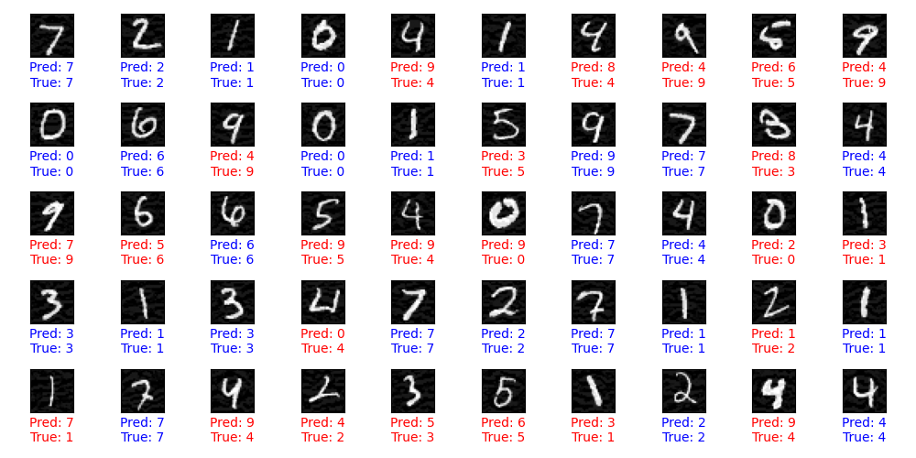
Eps=0.1
Accuracy on clean test examples: 0.9913
Accuracy on adversarial test examples: 0.6133
Accuracy drop due to adversarial attack: 0.3780
Number of correct predictions: 6133
Number of wrong prediction : 3867
Total test samples: 10000

Slide 22
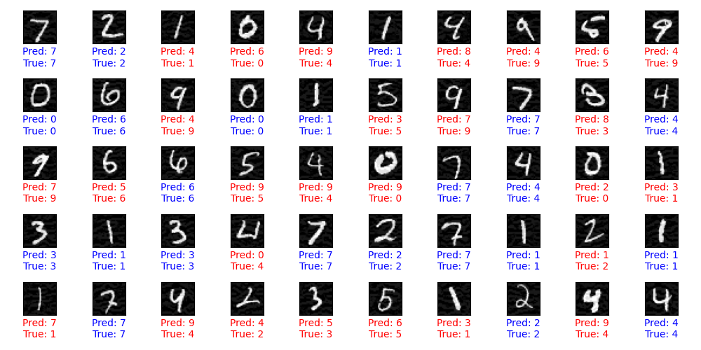
Eps=0.1 but max_it=100
Accuracy on clean test examples: 0.9913
Accuracy on adversarial test examples: 0.5803
Accuracy drop due to adversarial attack: 0.4110
Number of correct predictions: 5803
Number of wrong prediction : 4197
Total test samples: 10000

Slide 23
let’s move on to DeepFool Attack (DFool / L2 minimal perturbation attack)

Slide 24
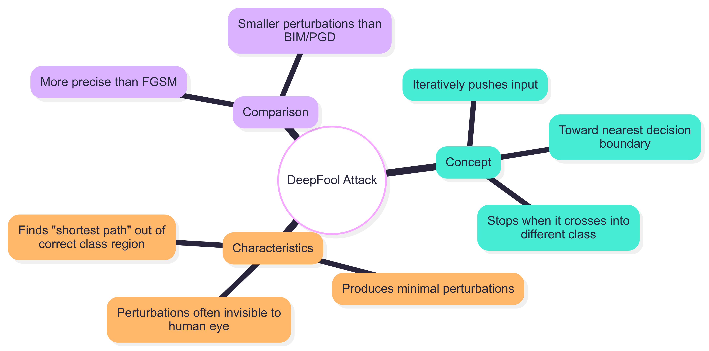

Slide 25
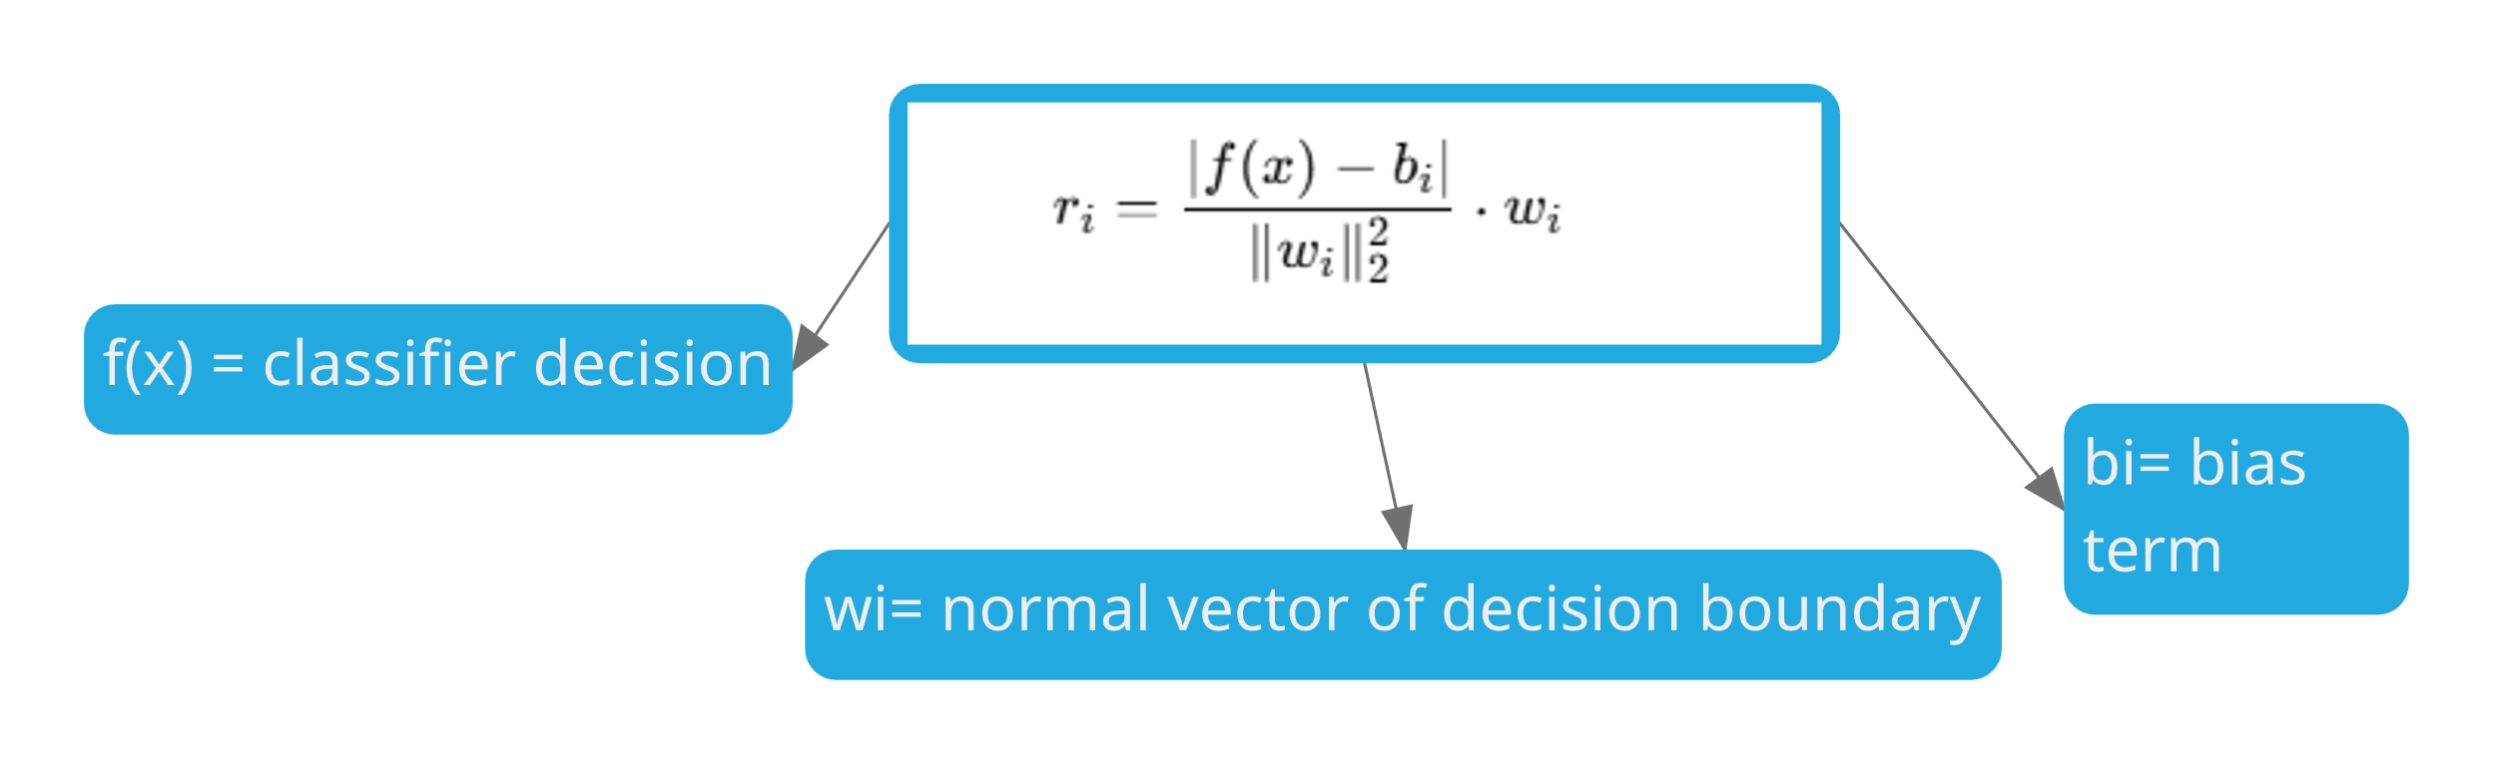

Slide 27
INPUT DATA
PREPROCESSING
ATTACK CONFIG
ATTACK ENGINE
ADVERSARIAL
MNIST Model
normalize
Normalize /255
setup
DeepFool(
generate
Find minimal
output
EXAMPLES
Test Images
Reshape to 4D
max_iter=50,
perturbation
Perturbed
(10,000 × 28×28)
ART Wrapper
epsilon=0.02)
per image
Images
(Same shape)
VISUALIZATION
Evaluation Pipeline
50 examples
Pred vs True
Color coding
CLEAN TEST
ADVERSARIAL TEST
COMPARISON
Original images
Perturbed images
Accuracy drop
→ Model accuracy
→ Model accuracy
Attack success
CLEAN
DEEPFOOL MAGIC
ADVERSARIAL
DeepFool Algorithm Steps
DATA
Minimal perturbation calculation
DATA
1. Linearize decision boundary
High Accuracy
Low Accuracy
2. Find closest hyperplane
3. Calculate minimal perturbation
4. Apply overshoot (epsilon)
5. Repeat until misclassified

Slide 28
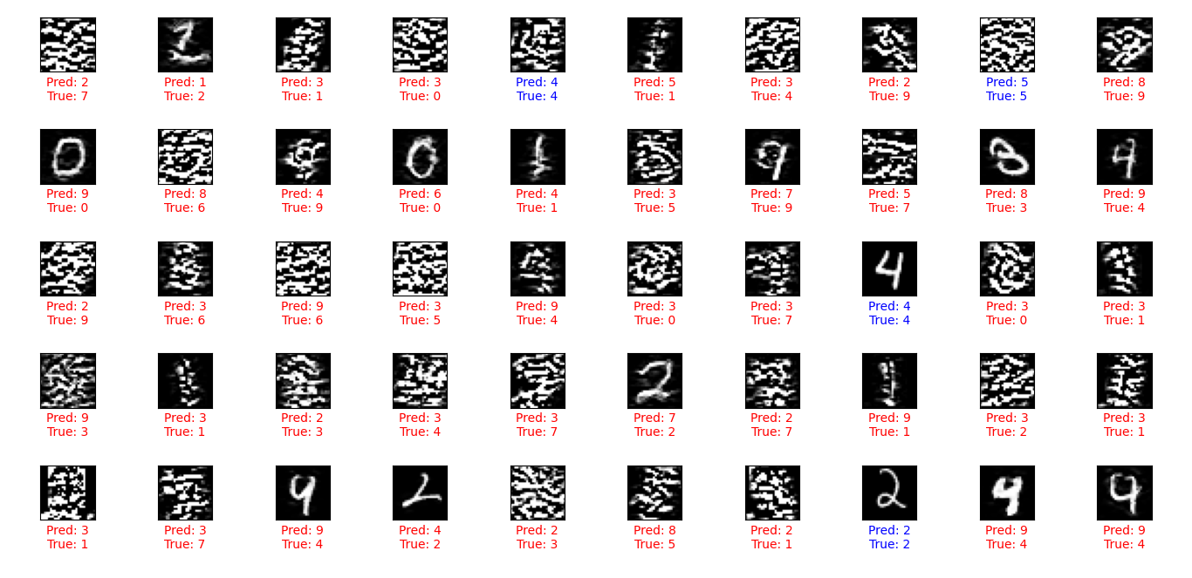

DeepFool with epsi =0.02
Accuracy on clean test examples: 0.9913
Accuracy on adversarial test examples: 0.1240
Accuracy drop due to adversarial attack: 0.8673
Number of correct predictions: 1240
Number of wrong prediction : 8760
Total test samples: 10000

Slide 29
let’s move on to the NewtonFool Attack

Slide 30
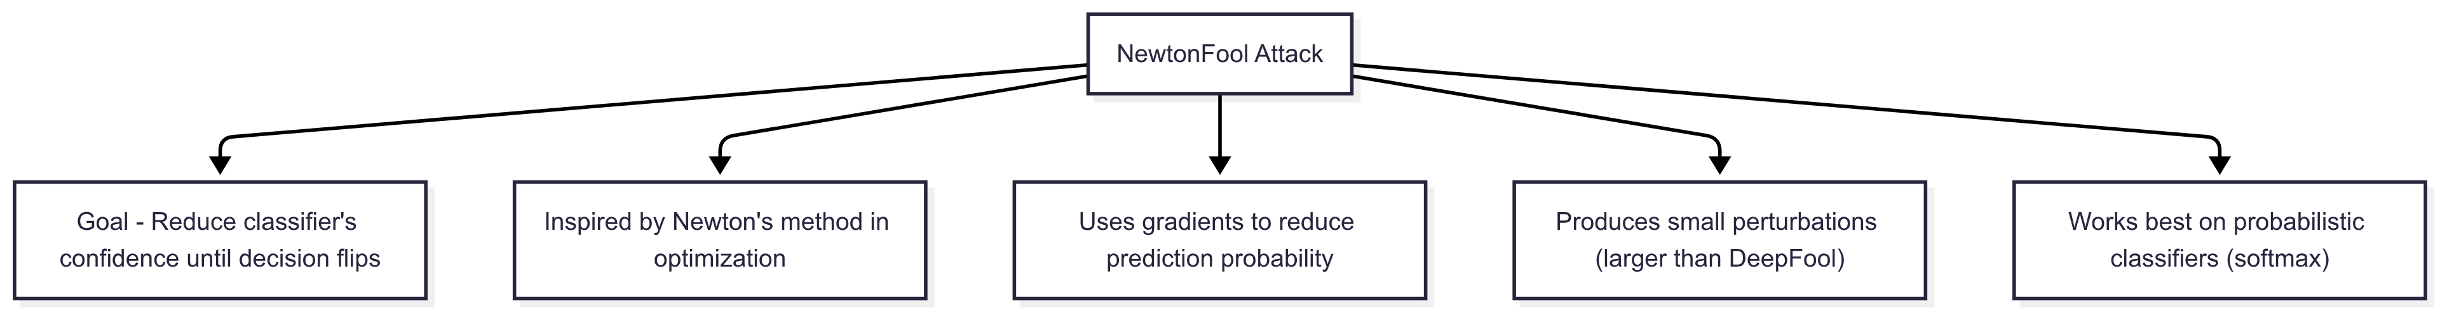

Slide 32
NewtonFool Attack Pipeline
NEWTONFOOL
DATA SAMPLING
NEWTON'S METHOD
ADVERSARIAL
CONFIG
subset
generate
ATTACK
output
EXAMPLES
max_iter = 1000
First 500 images
Second-order
500 perturbed
eta = 0.1
x_test_small[:500]
optimization
images
batch_size = 64
y_test_small[:500]
Hessian matrix
x_test_adv
(Newton's method)
(Reduced dataset)
computation
(High quality)
VISUALIZATION
Evaluation Pipeline
First 50 examples
Grid layout (5×10)
Prediction vs Truth
CLEAN TEST
ADVERSARIAL TEST
ANALYSIS
Full test set
500 attacked images
Accuracy drop
(10,000 images)
vs 500 labels
Success rate
→ Baseline accuracy
→ Attack accuracy
Statistics
SUBSET
NEWTON MAGIC
HIGH-QUALITY
500 samples
Hessian computation
adversarials

Slide 33
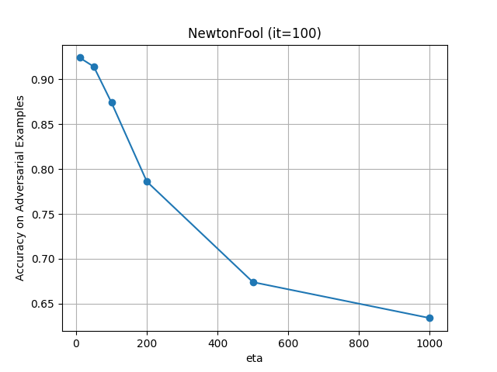
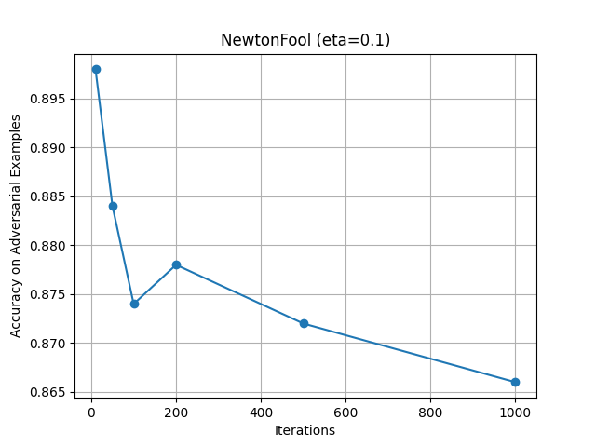


Slide 34
let’s move on to the JSMA Attack

Slide 35
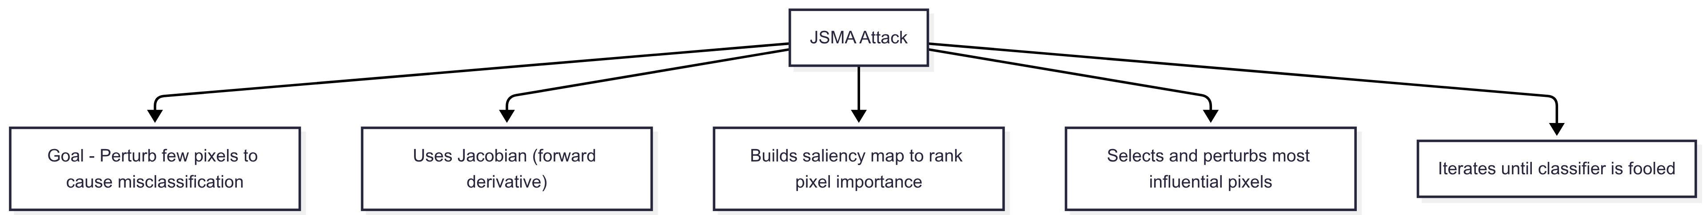

Slide 37
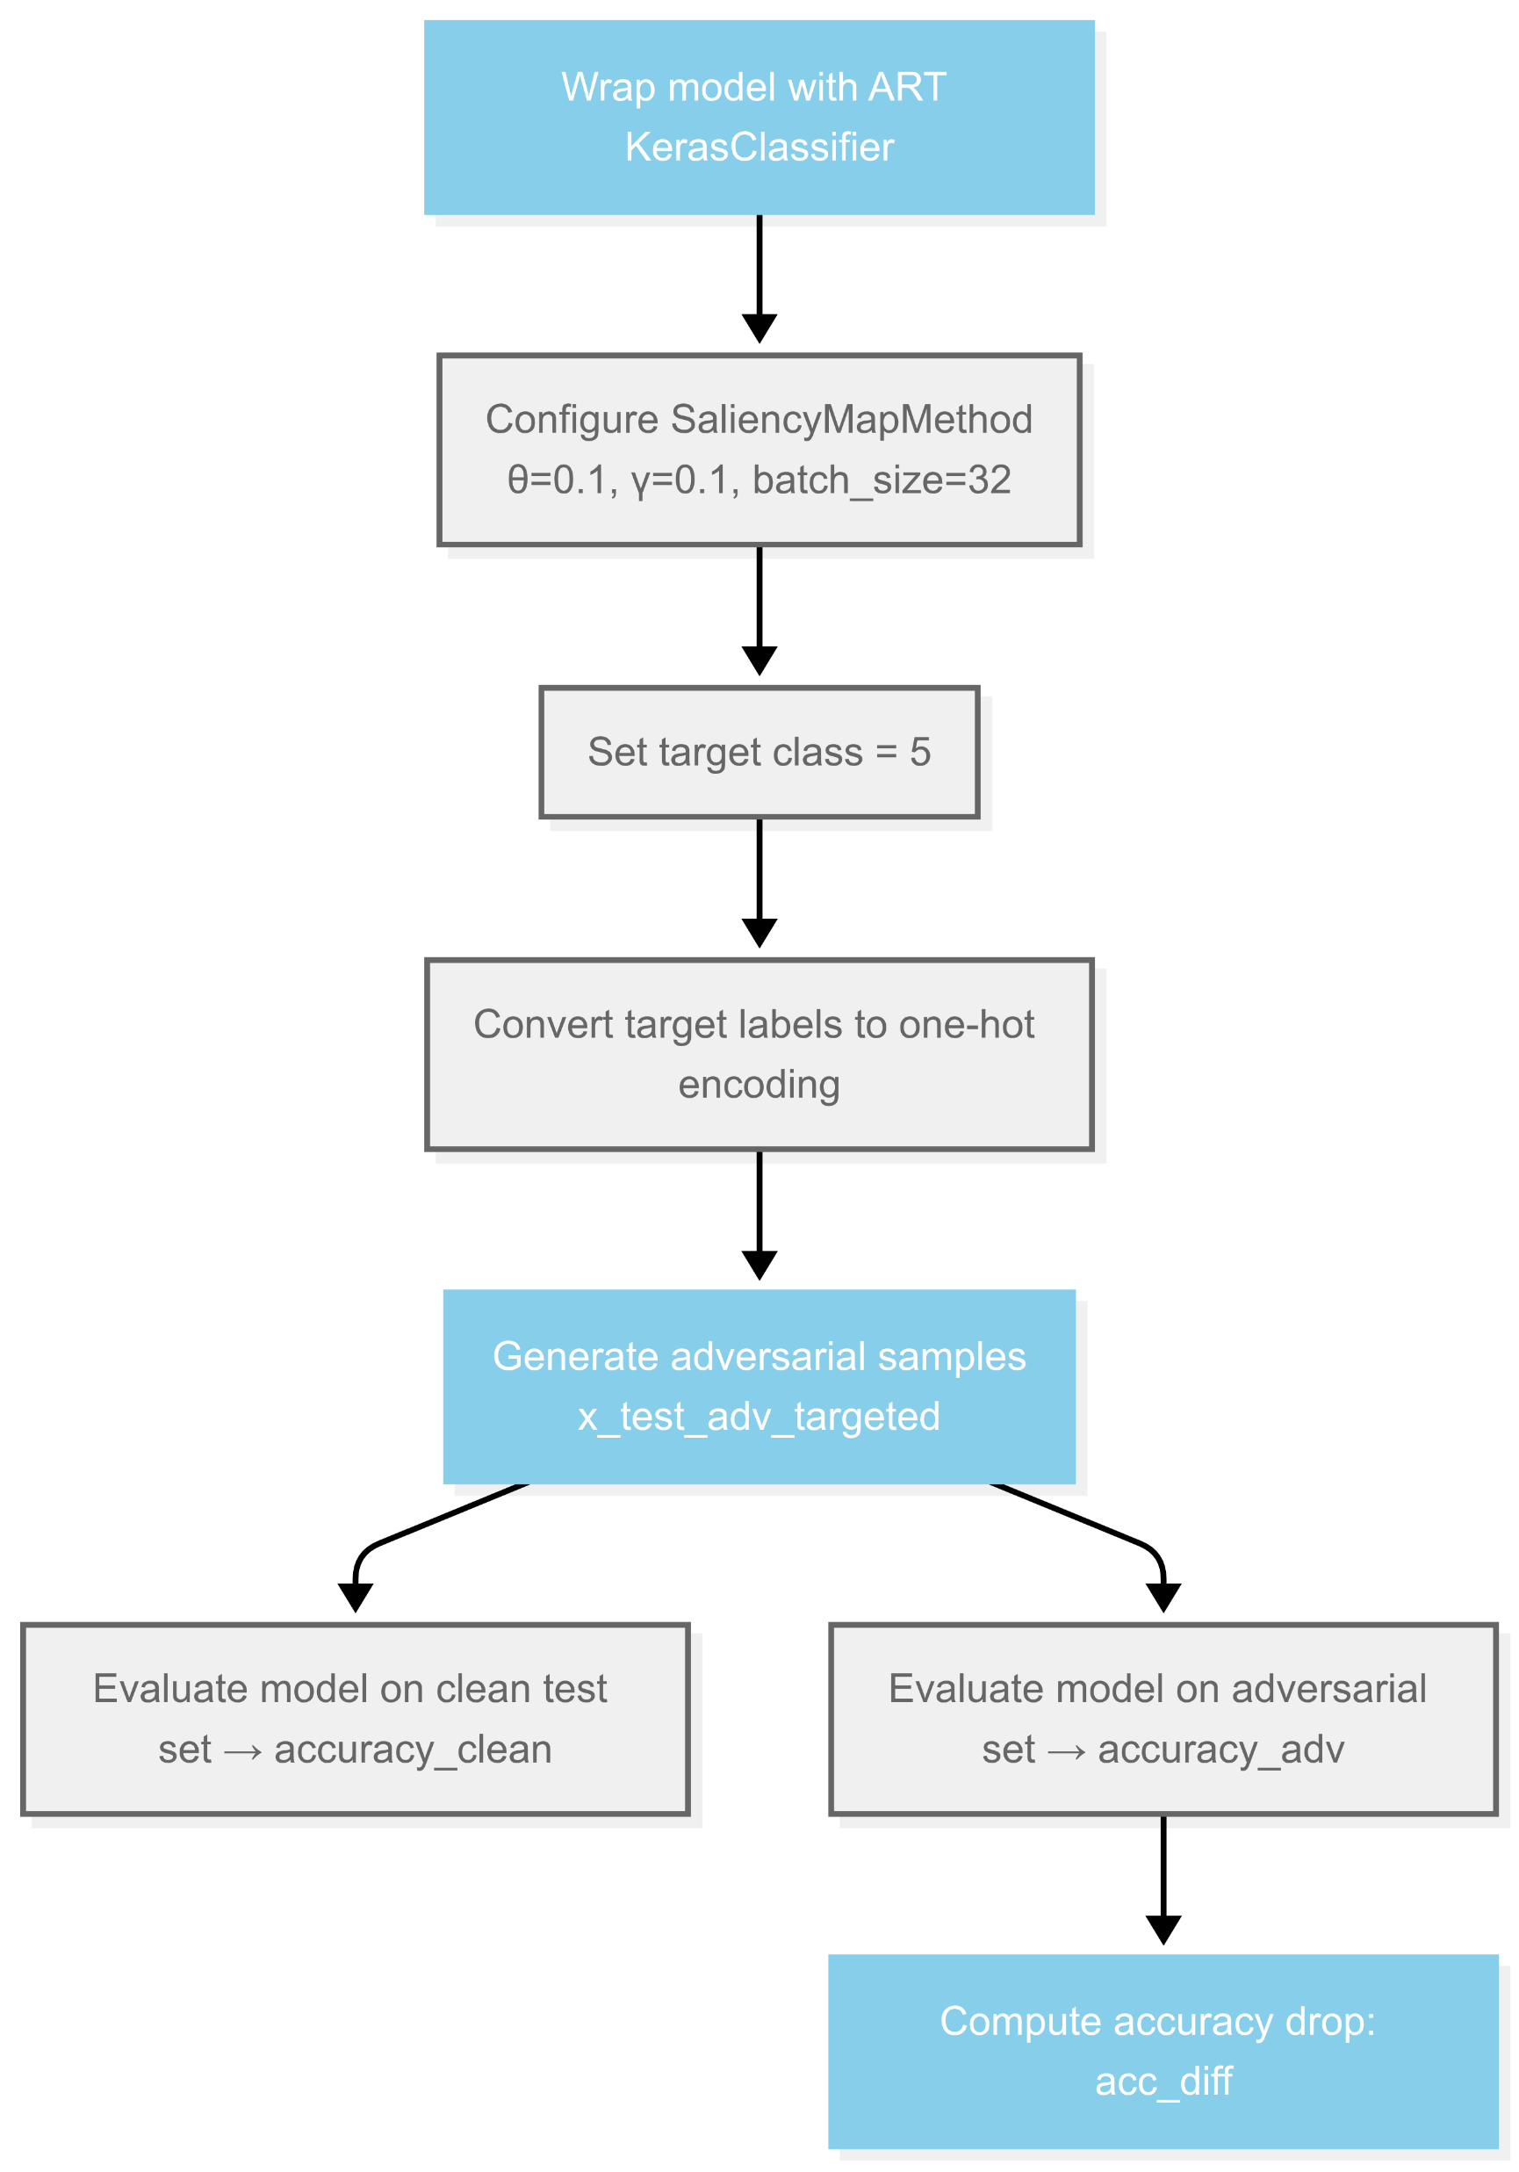

Slide 38
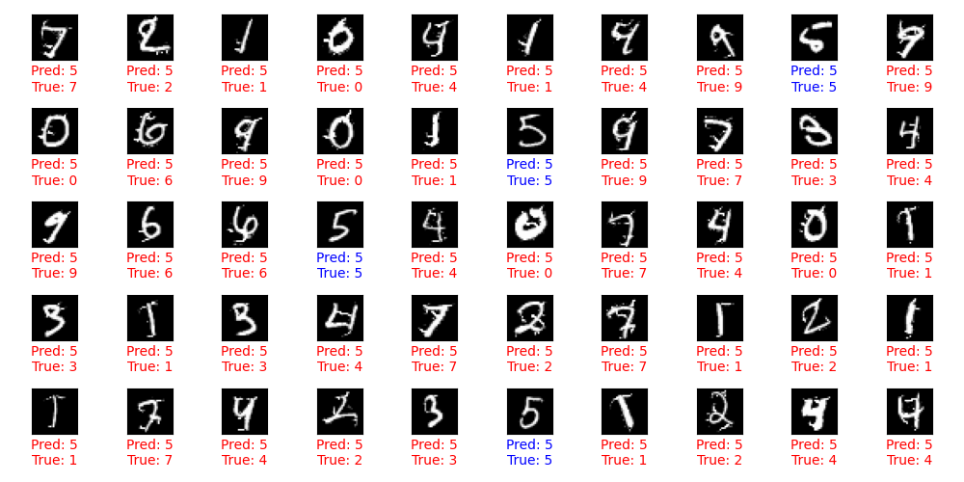
JSMA
Accuracy on clean test examples: 0.9900
Accuracy on adversarial test examples: 0.0700
Accuracy drop due to adversarial attack: 0.9200
Number of correct predictions: 7
Number of wrong prediction : 93
Total test samples: 100

Slide 39
let’s move on to the C&W Attack

Slide 40
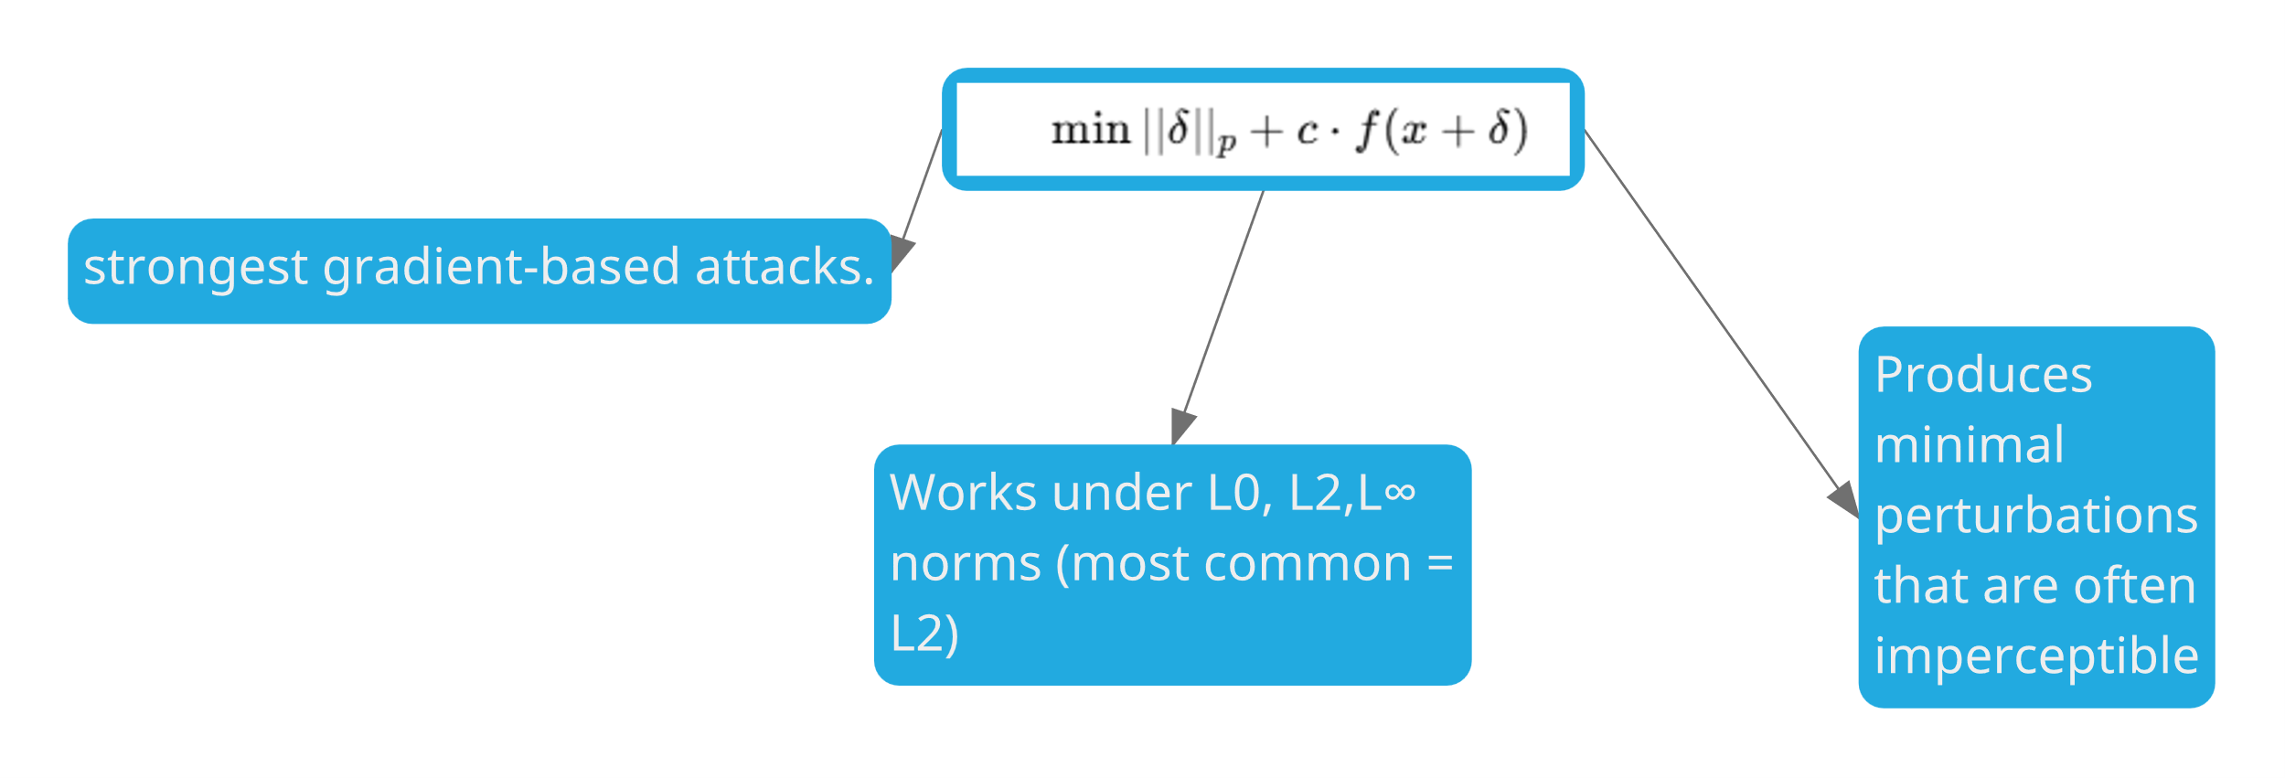

Slide 42
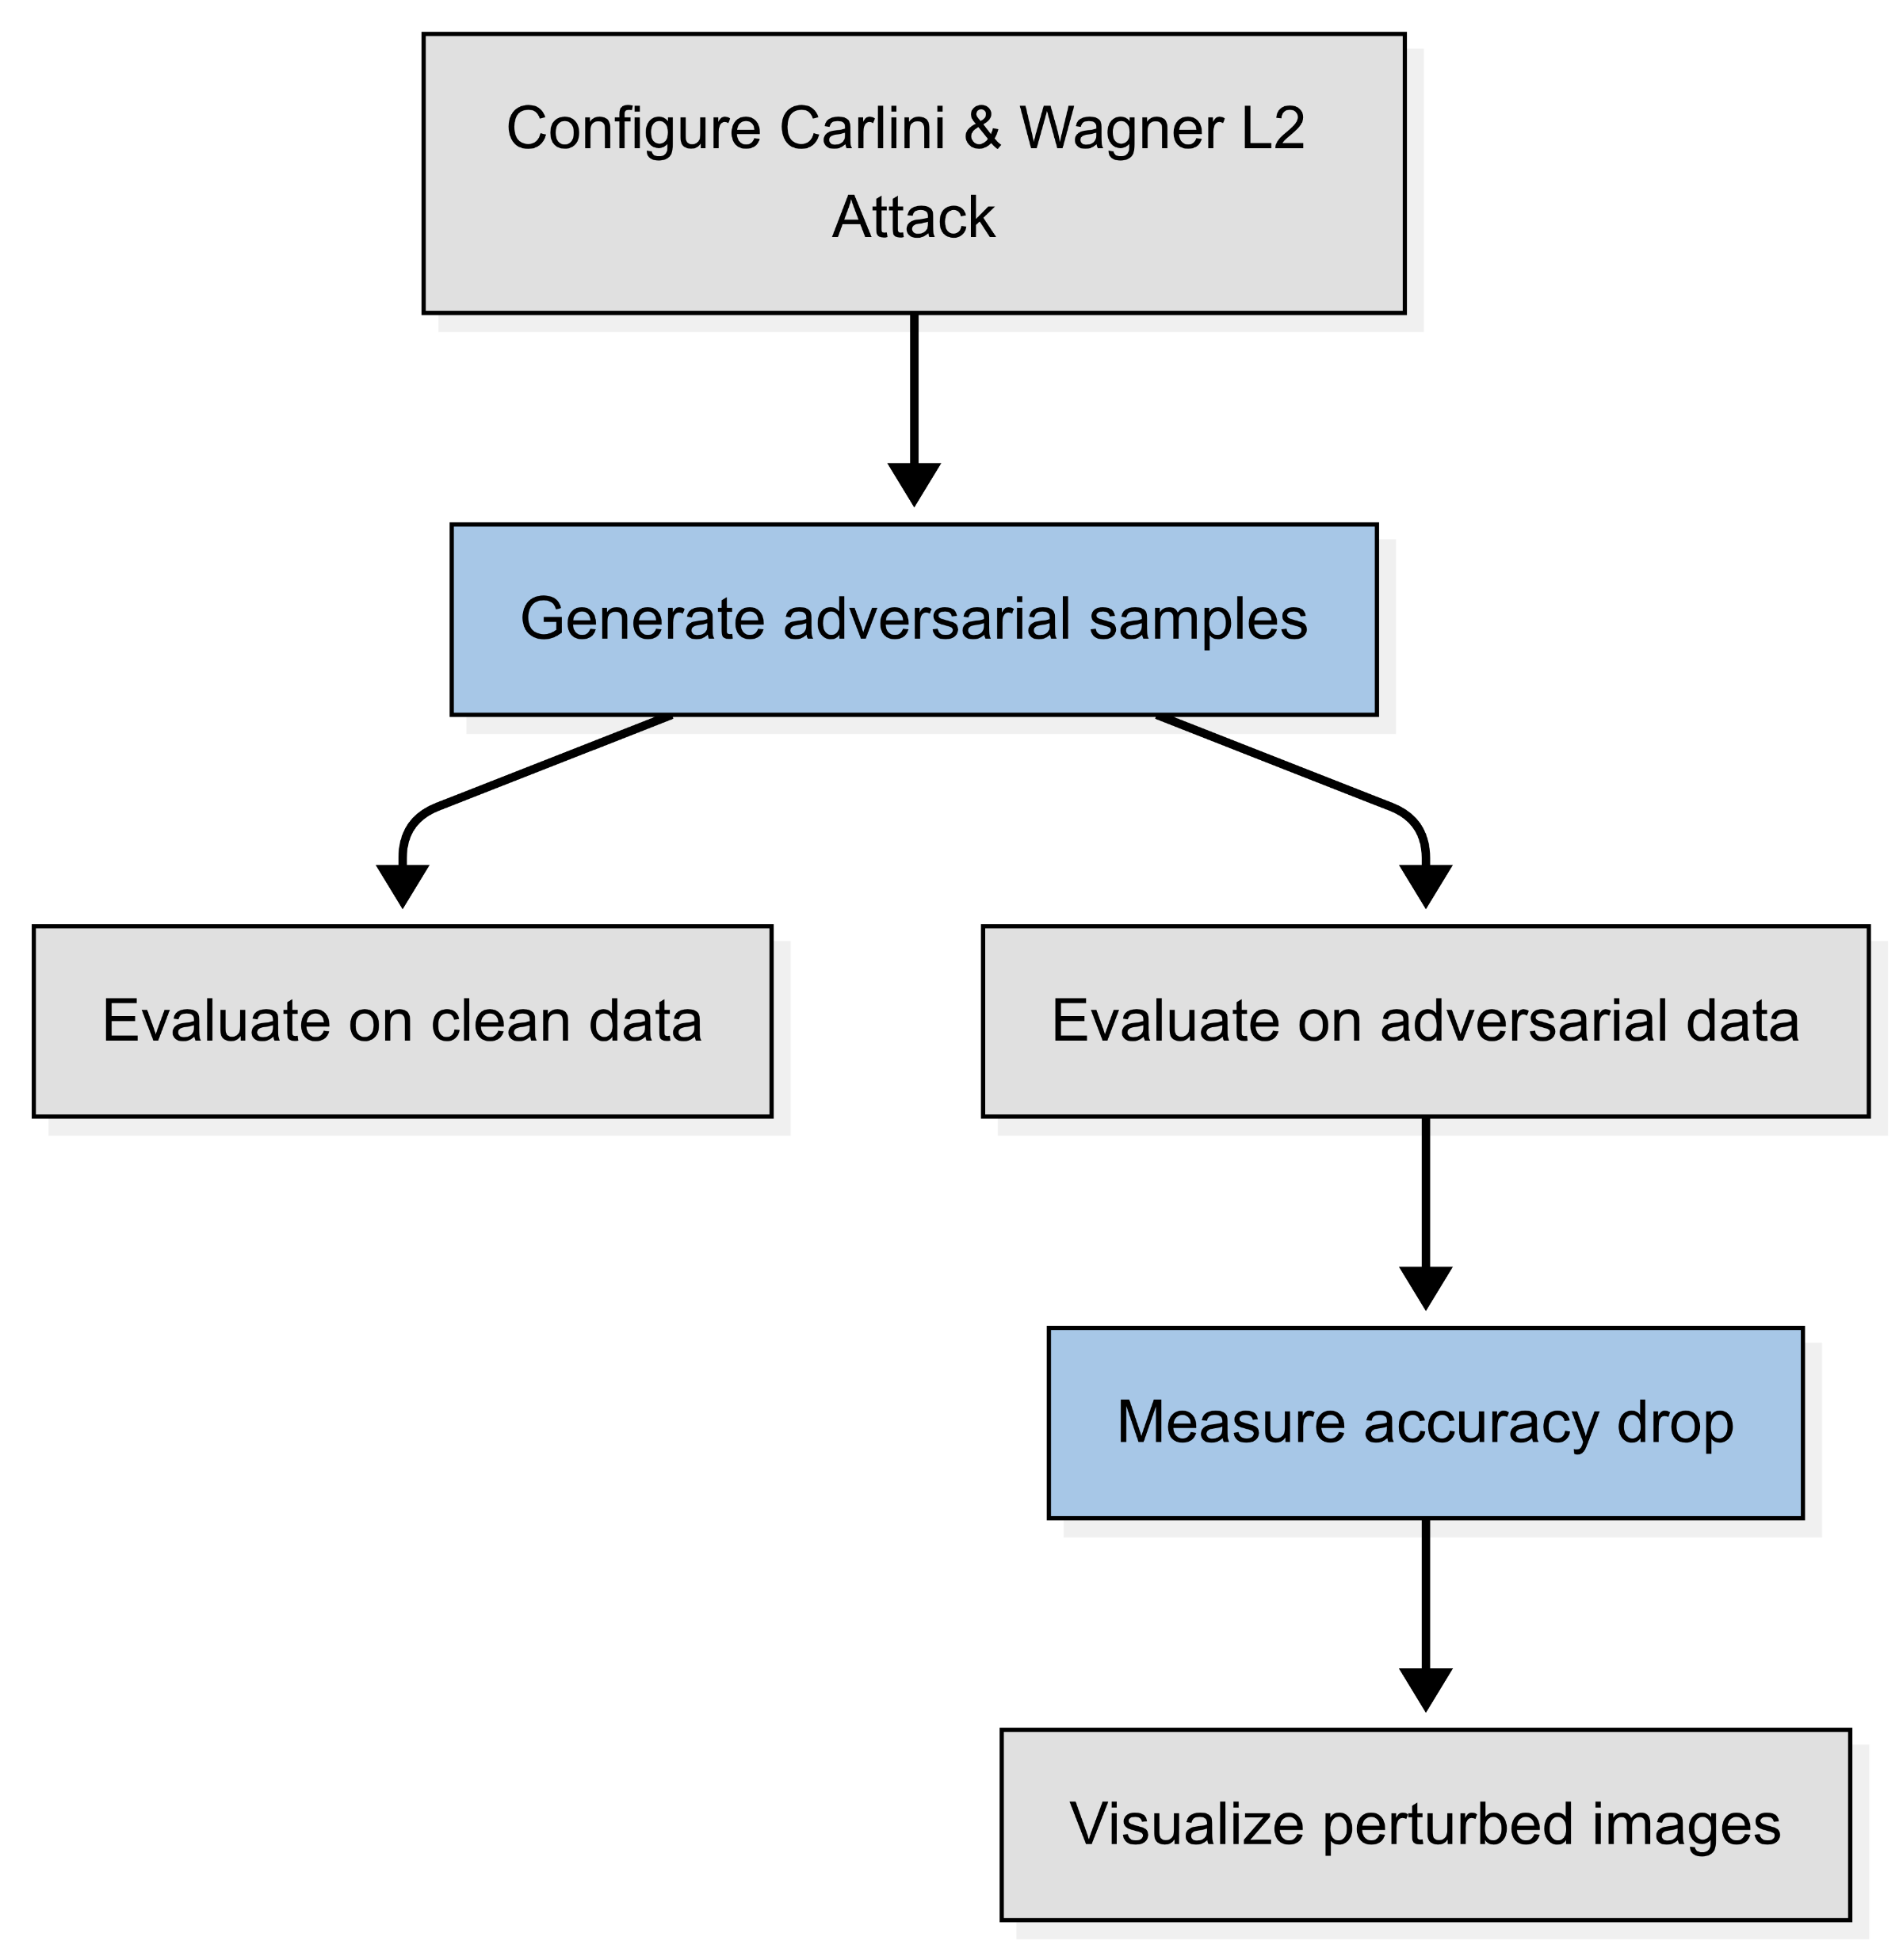

Slide 43
A
Explore Adversarial Attacks
.
No gradients, no parameters… just queries. Can the model still be broken?
White box attack
.
.
B
C
Black Box Attack

Slide 44
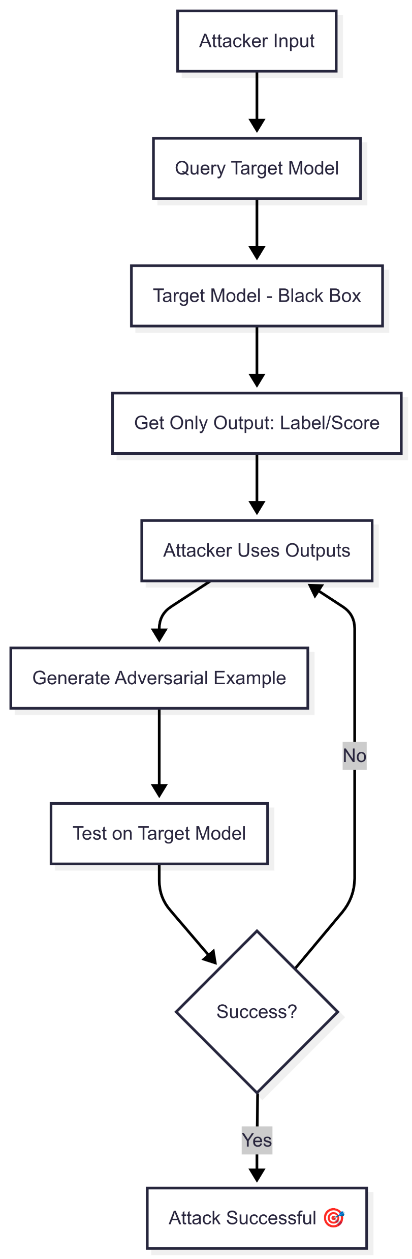

Slide 45
let’s move on to the Boundry Attack

Slide 46
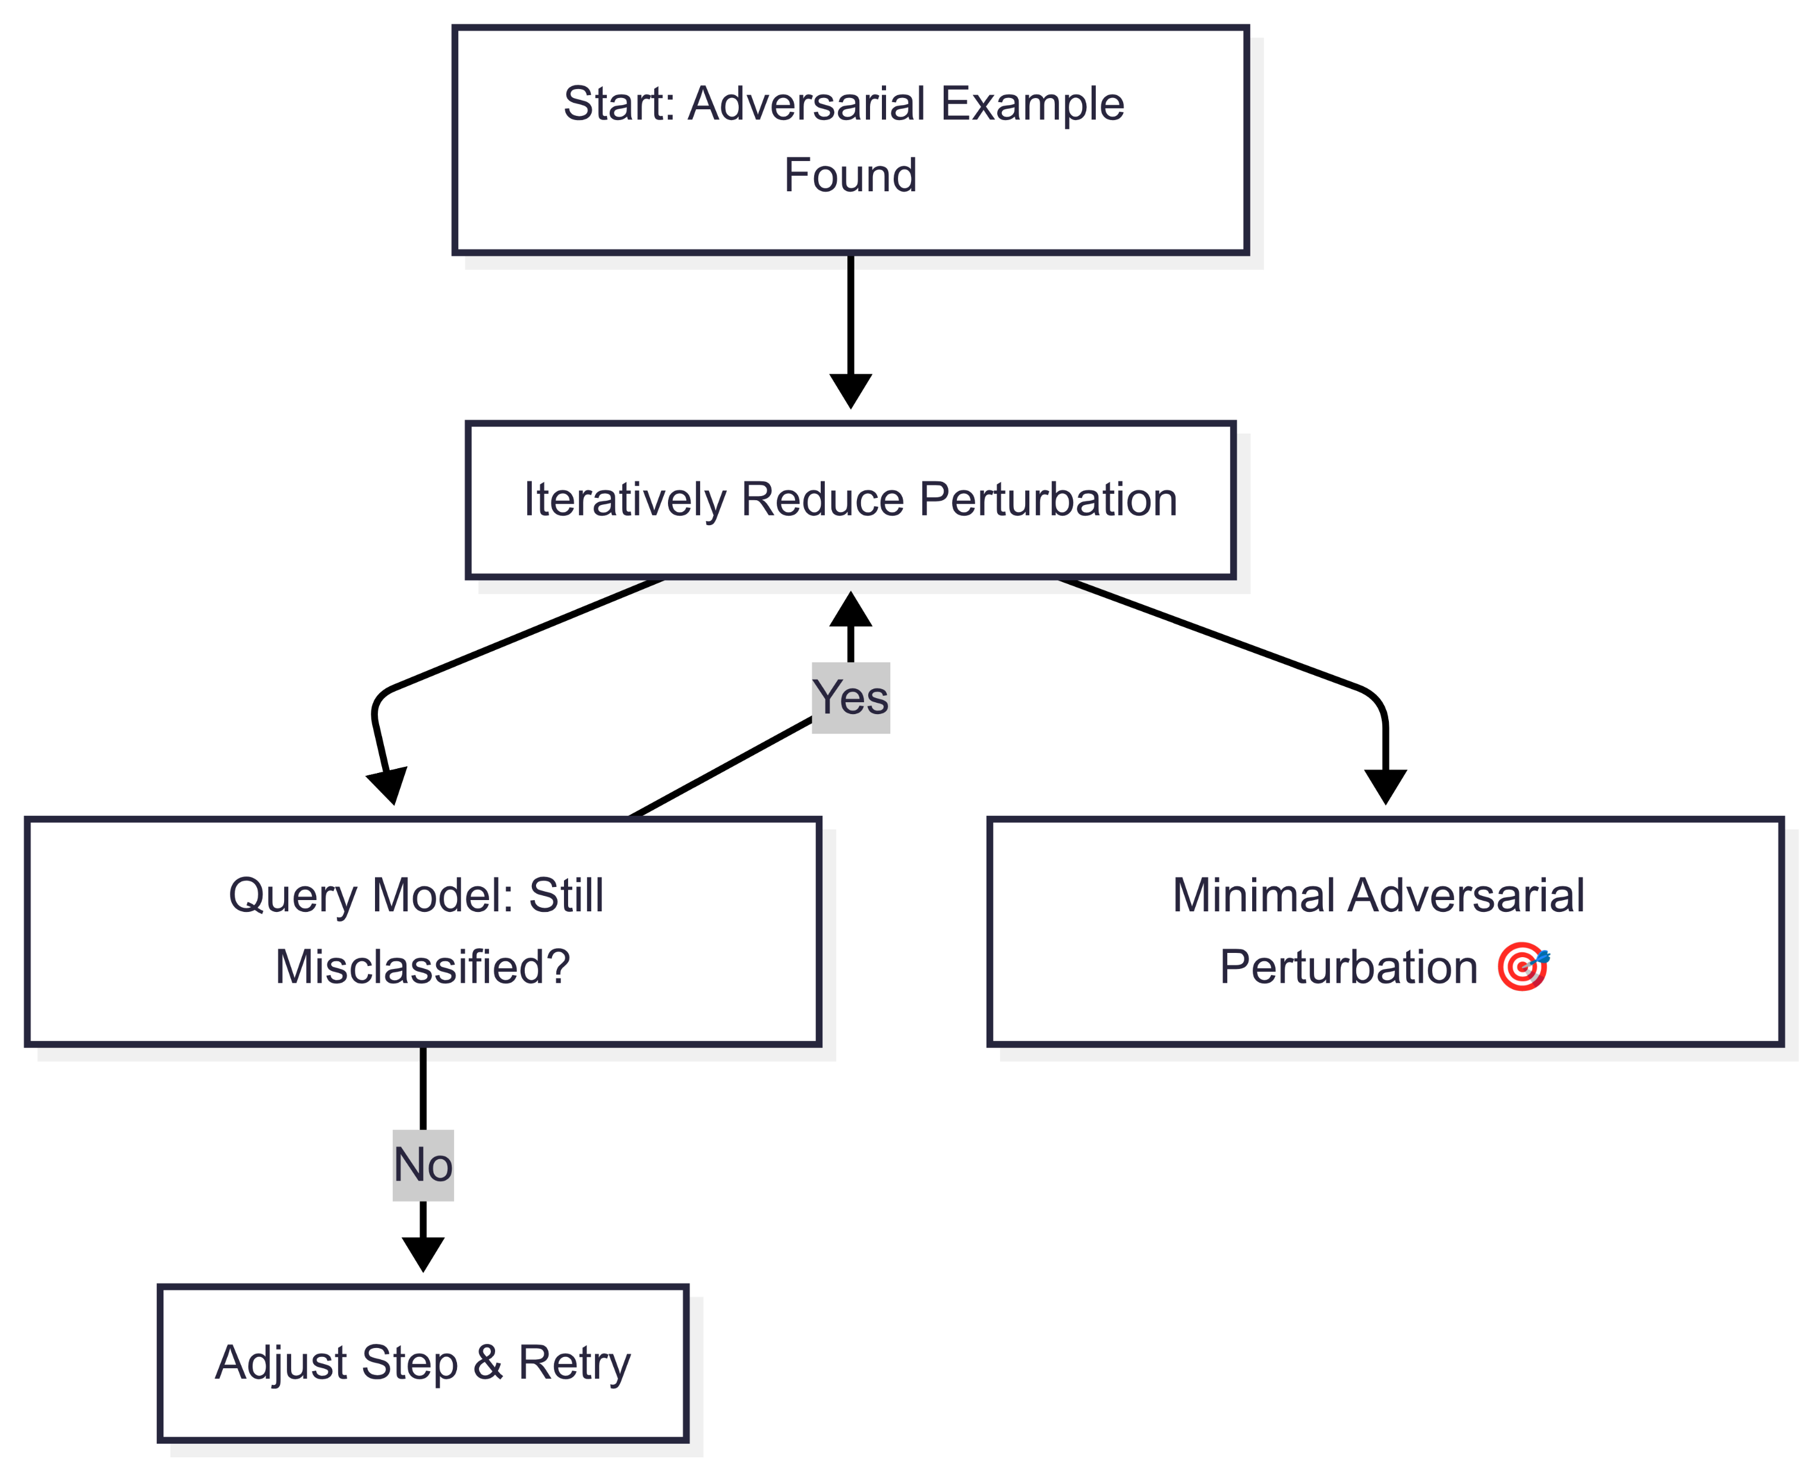

Slide 48
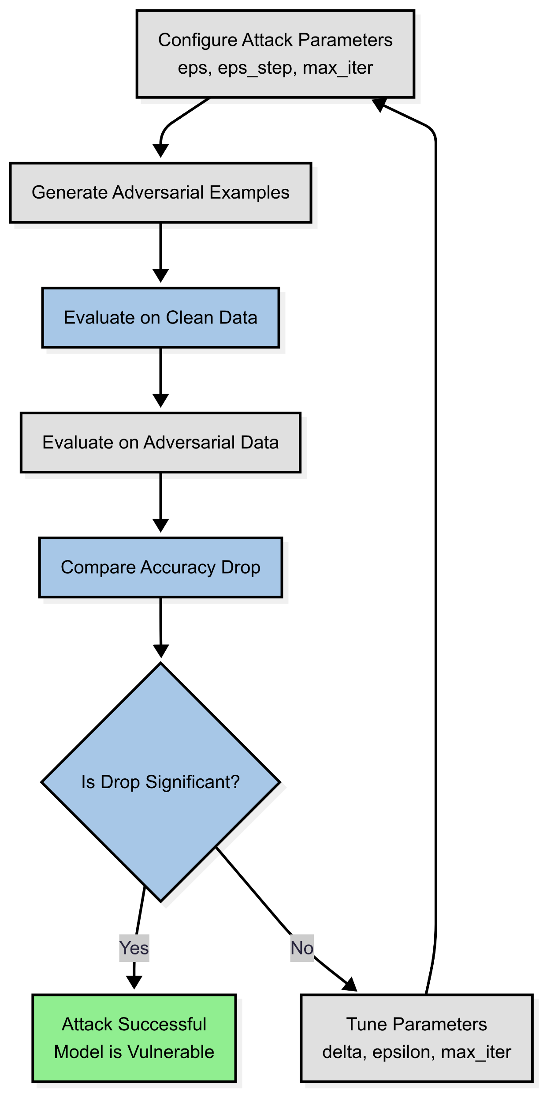

Slide 49
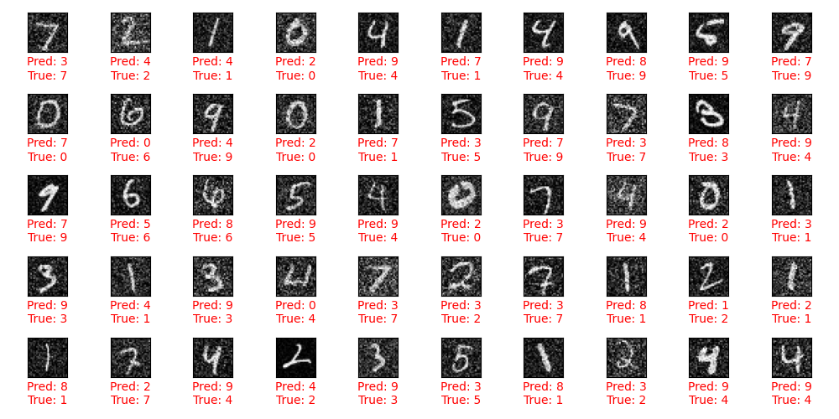
Boundry attack black box
Accuracy on clean test examples: 0.9913
Accuracy on adversarial test examples: 0.0100
Accuracy drop due to adversarial attack: 0.9813
Number of correct predictions: 5
Number of wrong prediction : 495
Total test samples: 500

Slide 50
let’s move on to the HopSkipJump Attack

Slide 51
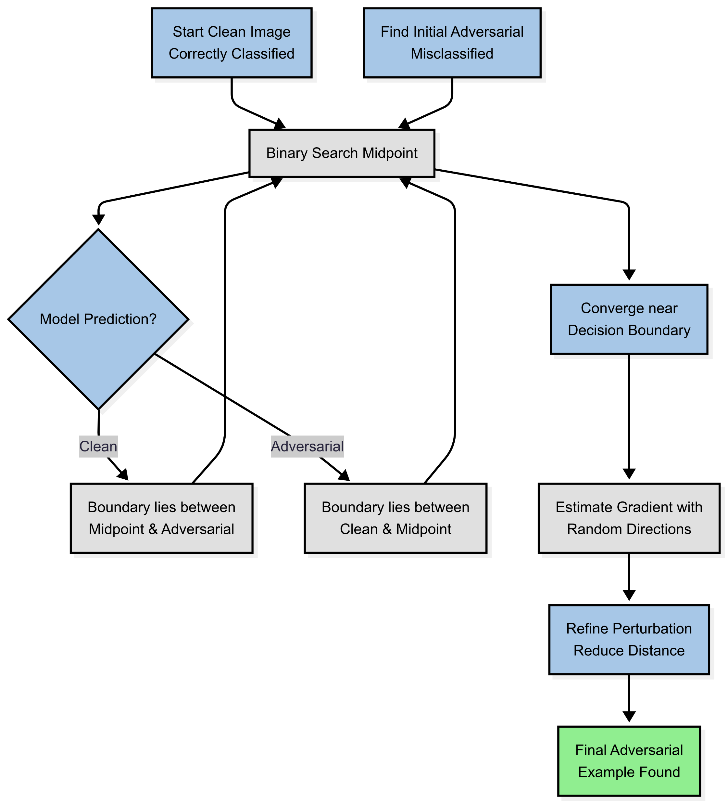

Slide 53
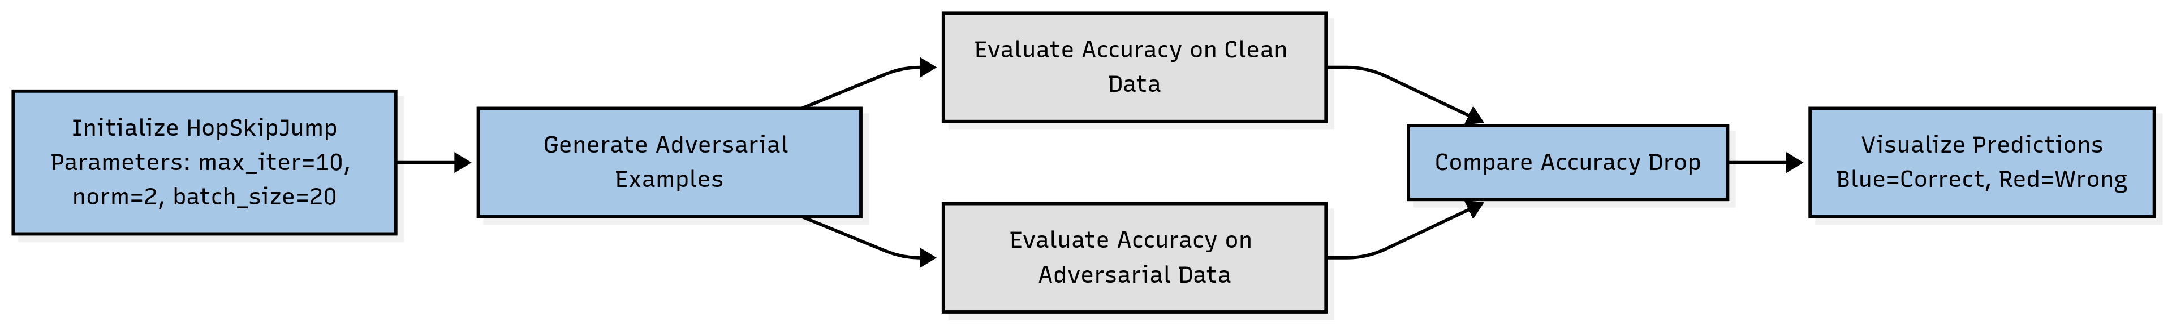

Slide 54
Explore Adversarial Attacks
.
A
What if the attacker doesn’t wait until test time… but instead poisons the training data itself?
White box attack
.
.
Black box attack
.
.
B
C
Poisoning ATTAck
D

Slide 55
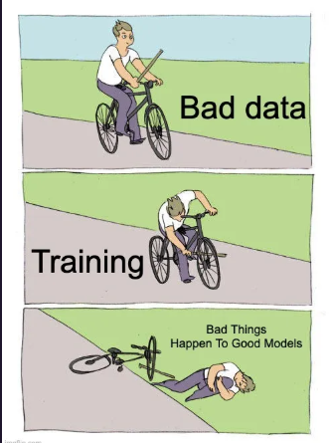

Slide 56


Slide 57
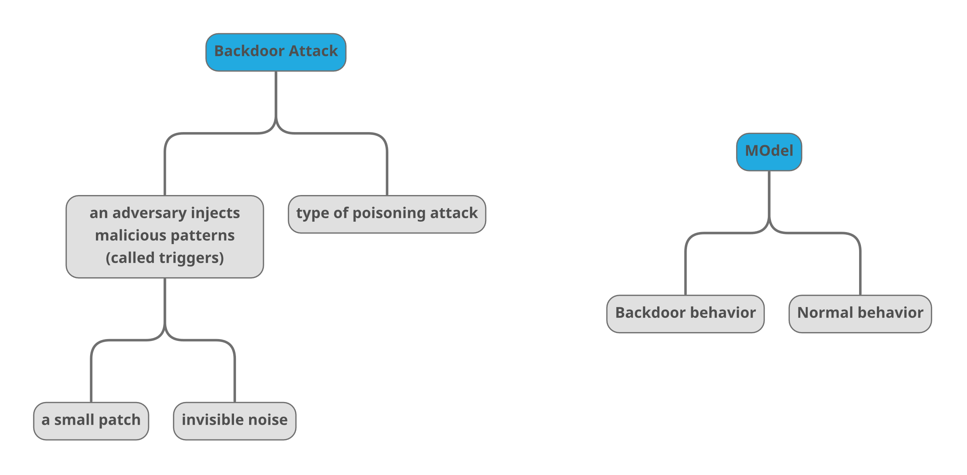

Slide 58
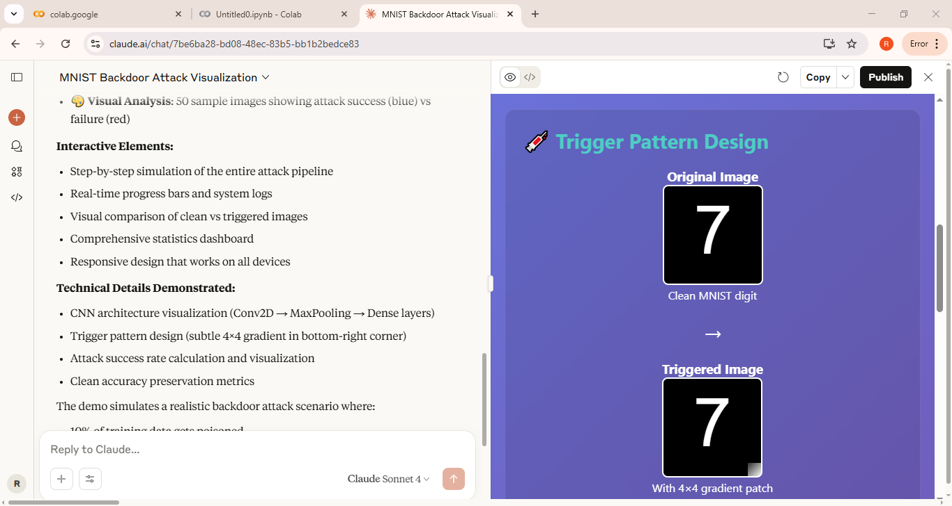
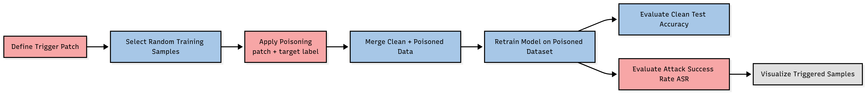
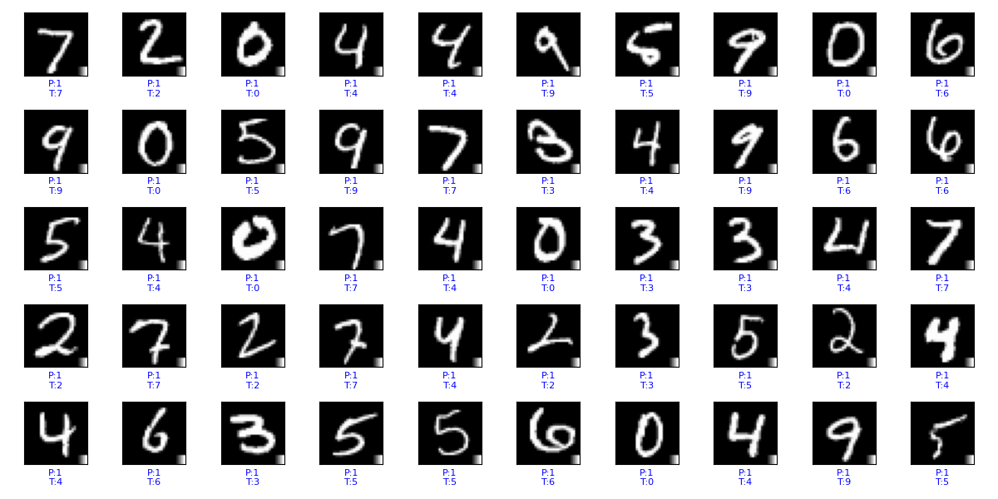
It should predict as target label when see the patch

Slide 59
Explore Adversarial Attacks
.
A
Let’s See ALL ATTACKS
White box
.
B
C
Black Box
Poisoning Attack
D
E
Demo Live

Slide 60


Slide 61
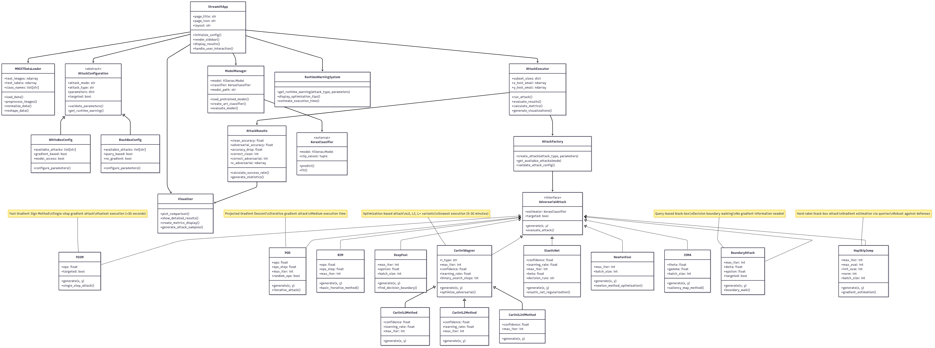
http://localhost:8501/

Slide 62


